Slide 1
Conditional Deep Convolution GAN to Generate SEM samples of Pd/C
By Sahil Shah

Slide 2
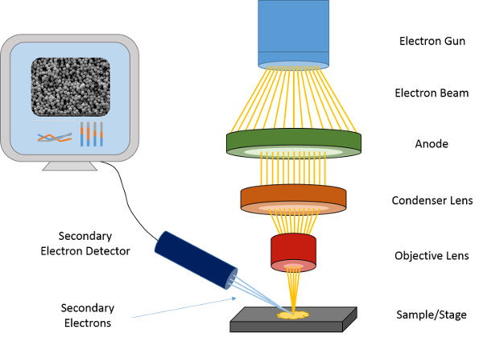
Scanning Electron Microscopy (SEM) Imaging Technique
Uses Electron Diffraction to generate morphological Structure
Intensity is the key feature (shows depth)

Slide 3
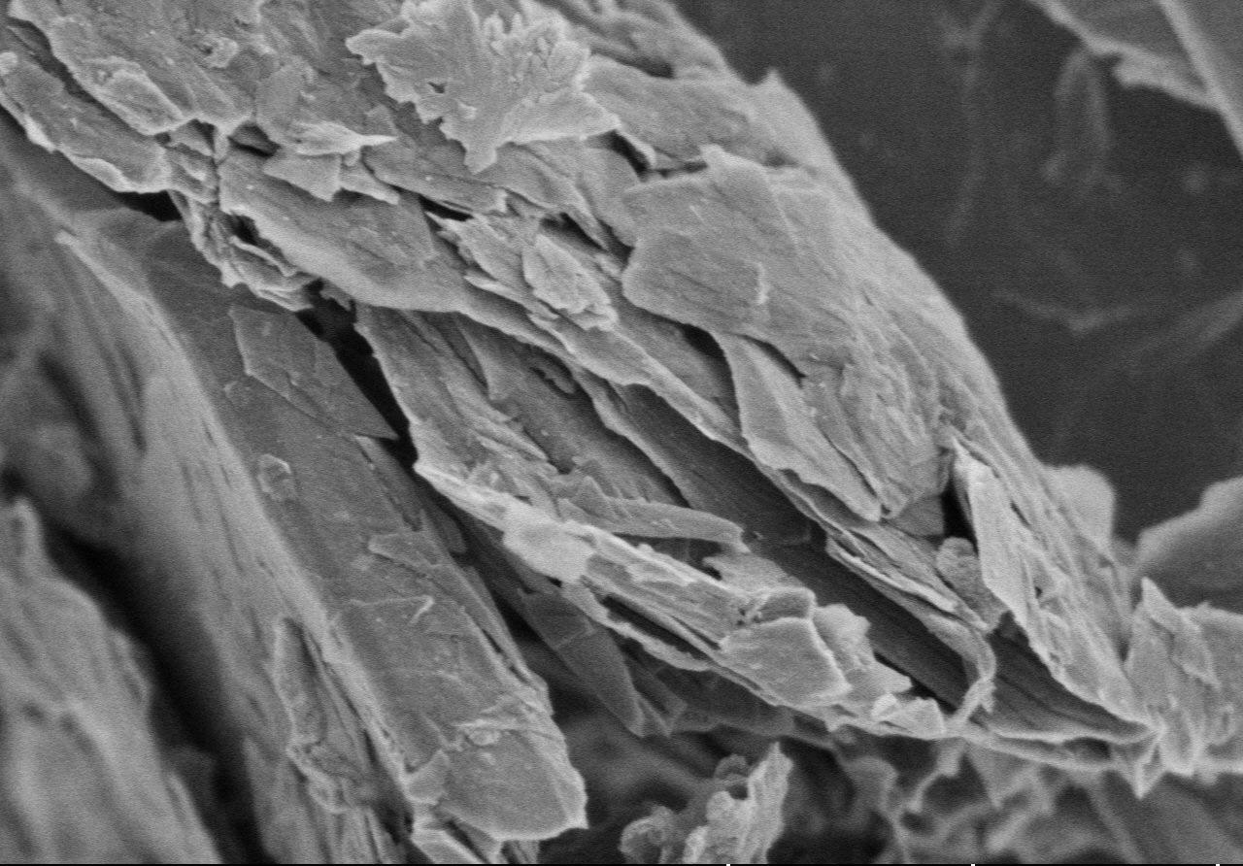
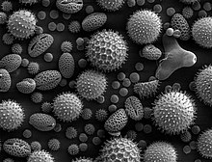
Problem with SEM
Cannot see electron defects, limited to atomic structure only
Pristine Graphene
(Source : Gnanomat Tech)
SEM Image of Biological Virus (Source : Wikipedia)

Slide 4
Atomic Structures Have Defects!!
Reactivity of the substance depends on the Defects and morphology of the material
Types of Defects
Vacancy Defects – Stones-Wales Defects
2D Defects – Grain Boundaries, Sheet Bends
Impurities
Study of Defects is important, it gives insights for inherent structure of the material. Defects are used in Semiconductor Industry.
Graphene is a rising star in material science, and that is what we choose to study in detail.

Slide 5
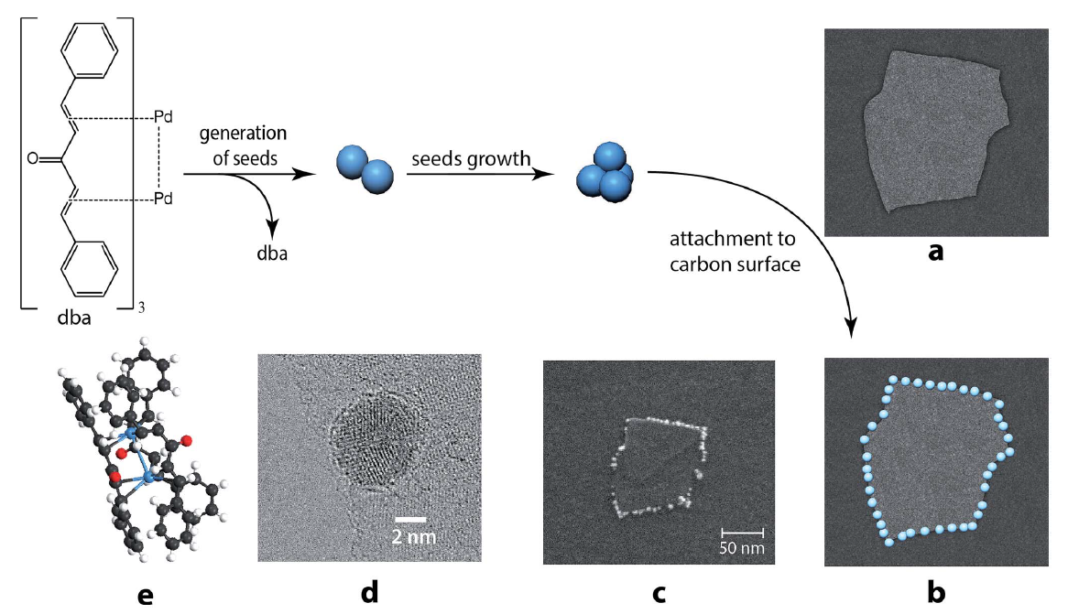
Imaging of Reactive Centre
Source - DOI: 10.1039/c5sc00802f

Slide 6
Original Dataset – Ordered Images
Sample S1
(Extra-Fine Graphite Powder)
(Source - doi.org/10.6084/m9.figshare.11926929)

Slide 7
Original Dataset – Unordered Images
Sample S4 (Pressed Graphite Bars)
Sample S5 (Pressed Graphite Bars)
Sample S3
(Nano-Granular Graphite)
(Source - doi.org/10.6084/m9.figshare.11926929)

Slide 8
Aim – Using GAN model to generate Synthetic SEM Images
Problem Statement - To generate Ordered and Unordered Images

Slide 9
Training Dataset
Sample S1 – Ordered (50 Images)
Sample S4 – Unordered (50 Images)

Slide 10
Image Processing
Using OpenCV
Raw Image (Cropped)
Grayscale conversion & Fast Non-Linear Means Denoising

Slide 11
Image Size
890
Resize
256
1280
256
Using Transforms, Resize, Normalize

Slide 12
1-Hot Class
Discriminator
Real or Fake
Real Image
Generator
1-Hot Class
Noise
Generated Images
References - https://github.com/eriklindernoren/PyTorch-GAN

Slide 13
Applications
Reducing time to actually take SEM Images and preparation of Samples
SEM Equipment is expensive
Can generate hidden representation (embeddings) which can be further used
Data Augmentation

Slide 14
Future Scope – To Make a Very good GAN for SEM
Improved DCGAN Architecture
Embeddings for the following would be required.
Substrate and Reagent
Time of Reaction
Concentration of reagent
Temperature for the reaction
Metric to compare if the generated image is actually close to real samples.

Slide 15
Thank You
Sahil Shah

